Slide 1

Deepfake Technology
Hitesh
A023119820027

Slide 2
What Is a Deepfake?
Deep Fakes are videos or images that replace sometimes likeness with someone else.
It is the next level of fake content creation that takes advantage of artificial intelligence (AI).
The phenomenon gained its name from a user of the Reddit platform, who went by the name “deepfakes” – (deep learning + fakes).

Slide 3
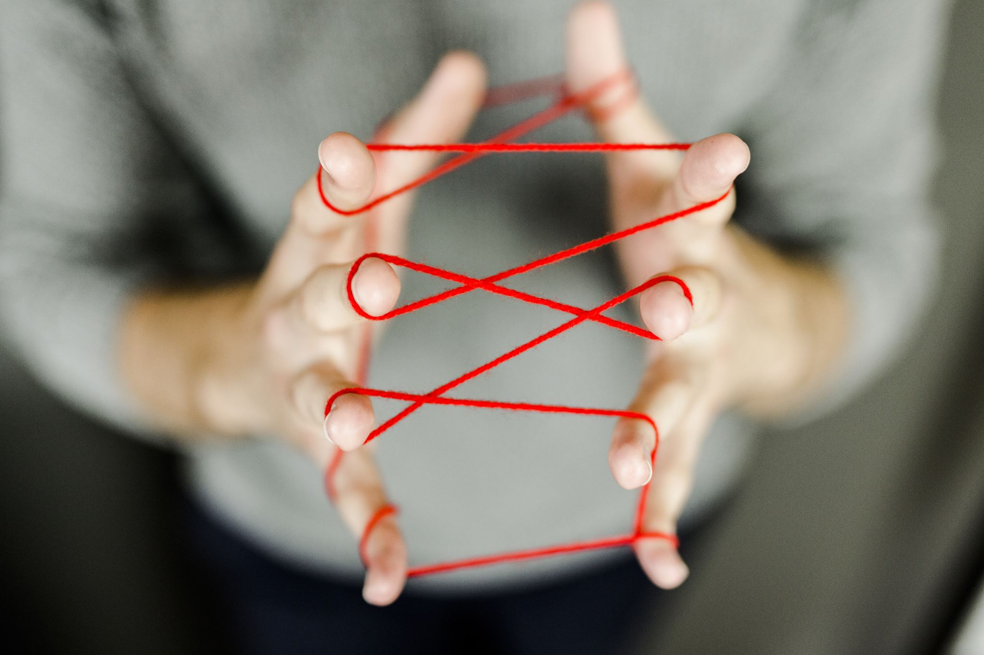
Creating a Deepfake
The deepfake creation process requires three steps: extraction, training and creation. This section will explain, at a top-level, what each of these stages mean and what they do in relation to the entire process.

Slide 4
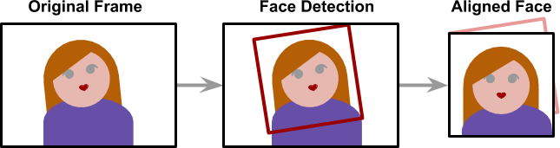
Extraction
Deepfakes leverage deep neural networks to transform faces and require large amounts of data (images) to make it all work smoothly and believable. The extraction process refers to the step of extracting all frames from video clips, identifying the faces and aligning them to optimze for perfomance.
The alignment is a critical step since the neural network that performs the faceswap requires all faces to have the same size (usualyl 256 x 256) and aligned features. Detecting and aligning faces is a problem that is considered mostly solved and is done by most applications very efficiently (face detection).

Slide 5
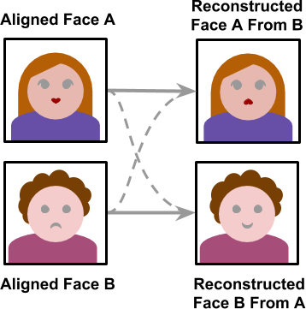
Training
The training stage allows the neural network to convert a face into another. The training may take several hours or even days depending on the size of the training set and the device the model is trained on. Like training most other neural networks the training only needs to be completed once. Once the model is trained it would be able to convert a face from person A to person B.

Slide 6
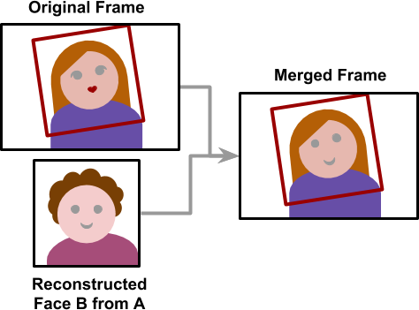
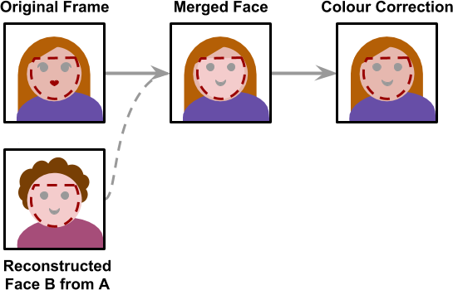
Creation
Once the model is trained, a deepfake may be created. Starting from a video, frames are extracted,` and all faces are aligned. Each frame is then converted using the trained neural network. The final step is to merge the converted face back to the original frame.
The creation stage is the only one which does not make use of any machine learning algorithms. The process is to stich a face back onto an image is hard-coded and thus lacks the ability to detect mistakes.
Each frame is also processed independitly which means there is no temporal correlation. A temporal correlation function is a function that gives the statistical correlation between random variable, contingent on the temporal (time) distance between those variables. The lack of this correlation results in the final video having some flickering.

Slide 7
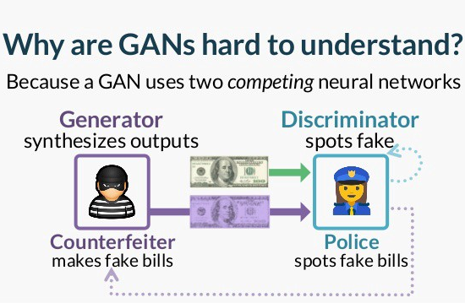
What is a Generative Adversarial Network (GAN)?
A generative adversarial network (GAN) is a computing procedure that uses two neural networks, which are considered “adversaries” of each other. These deep neural networks produce new and fabricated data that can easily mimic real information. In real life, GANs help in image, video, and voice generation. They are the very devices used to produce deep fakes.
You can consider the components of a GAN (the generator and the discriminator) as representations of a criminal and a cop, where the criminal mixes fake with real money for purchases. In contrast, the police detects which of the notes are counterfeit.

Slide 8
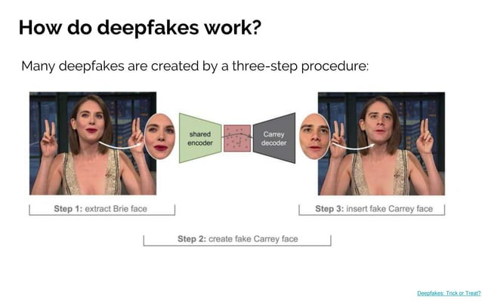

Slide 9
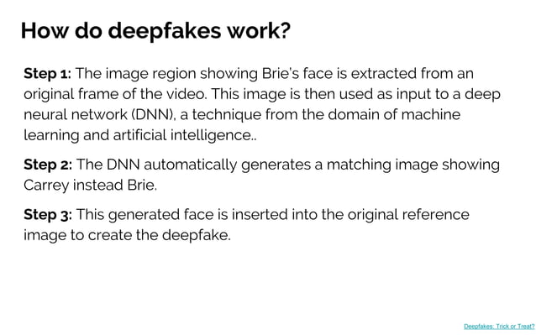

Slide 10
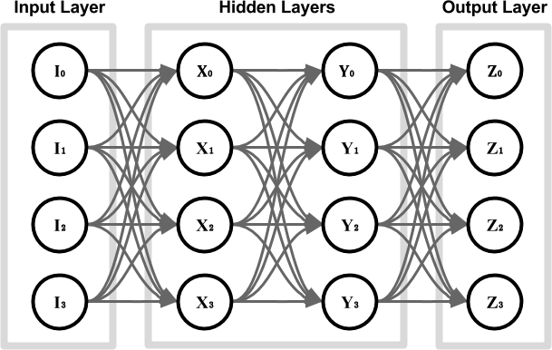
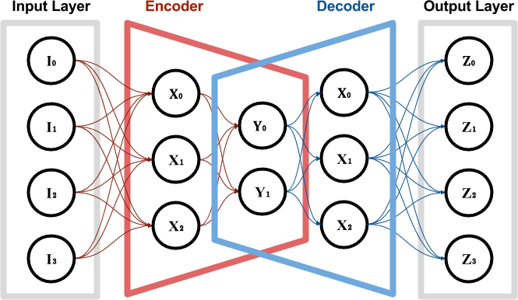

Slide 11
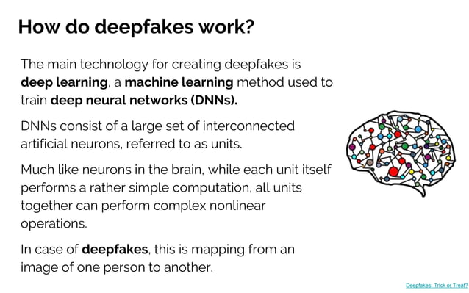

Slide 12
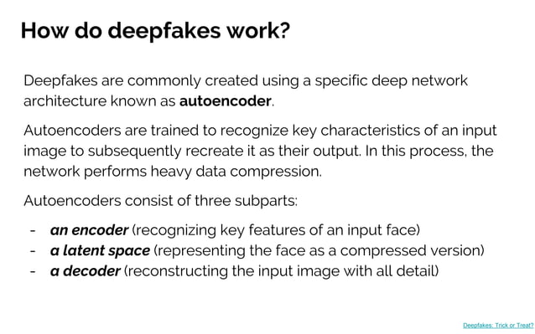

Slide 13
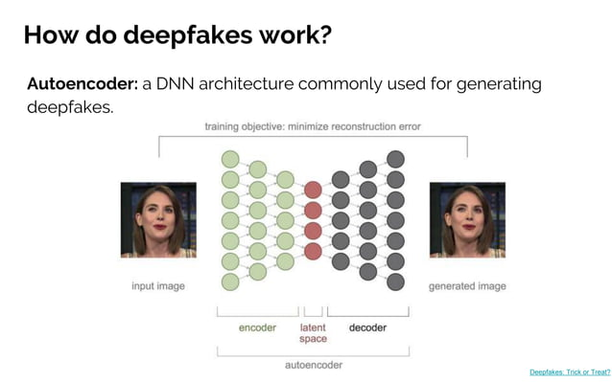

Slide 14
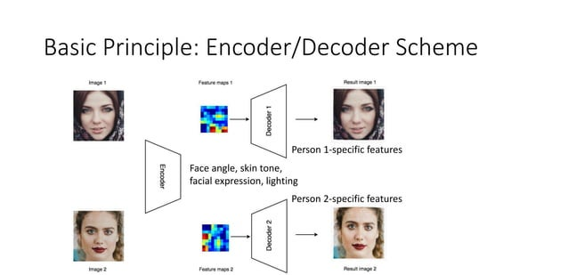

Slide 15
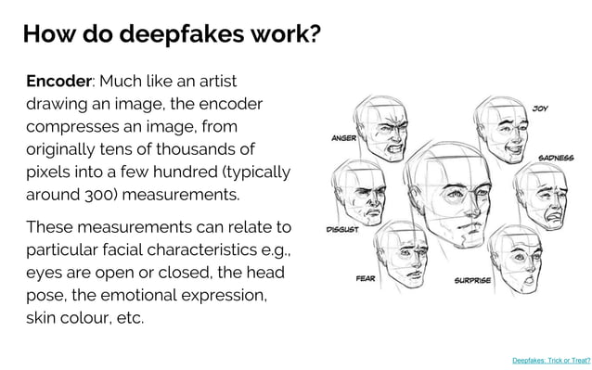

Slide 16
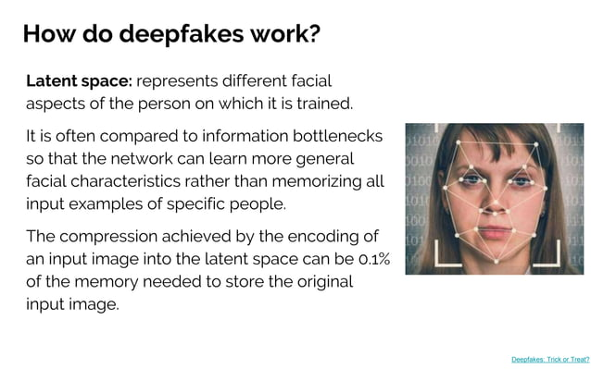

Slide 17
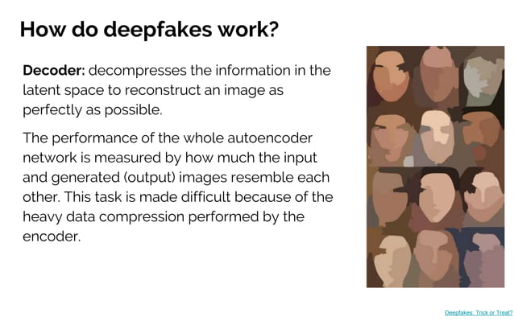

Slide 18
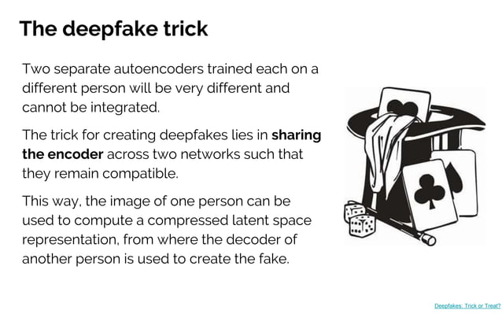

Slide 19
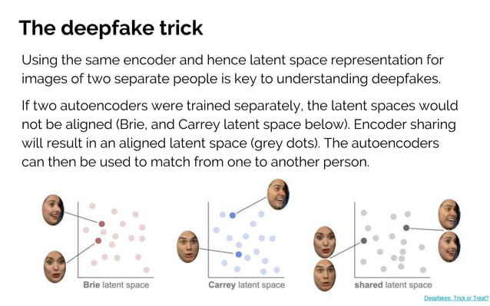

Slide 20
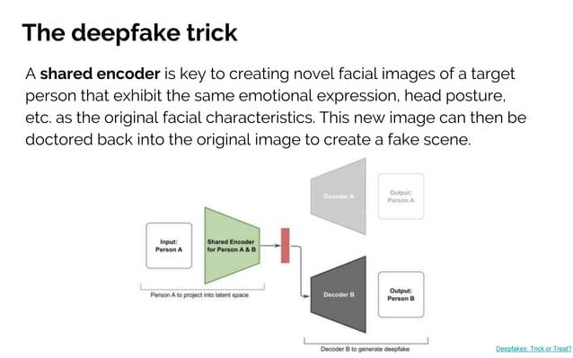

Slide 21
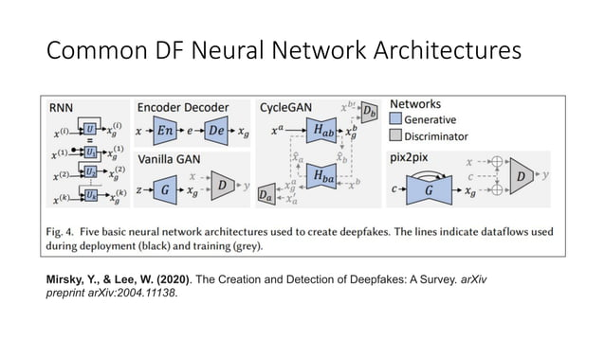

Slide 22
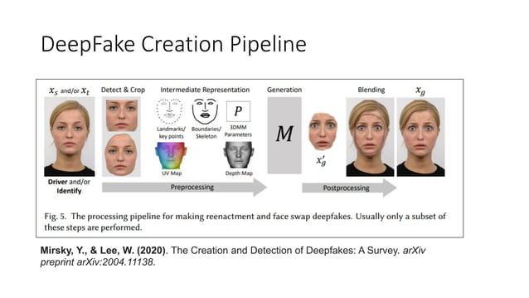

Slide 23
Pros of Deepfakes
Deepfakes can be used as a form of art to bring people from the past back to life. For example, a painting of the Mona Lisa can be used for generating a synthetic image of talking Mona Lisa as a form of art.
Deepfake technology can be used to create AI avatars in training videos. Startups like London-based Synthesia have been getting more attention from the corporate world during the COVID pandemic since lockdowns and health concerns have made video shoots involving real people much more difficult to pull off.
Deepfakes can be used to create personal avatars to try on clothes or new hairstyles before trying them in real.
Deepfakes can also be used in identity protection and anonymization in various fields like investigative news reporting, finance, etc.

Slide 24
Cons of Deepfakes
Deepfakes can be used to spread fake news with morphed videos of celebrities.
Deepfakes can also be misused for creating misinformation campaigns on social media that can shift public opinion and lead to negative consequences.

Slide 25
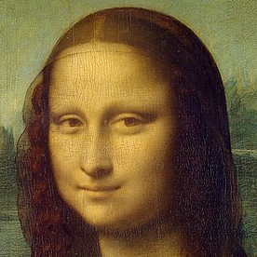

INPUT SOURCE IMAGES

Slide 26
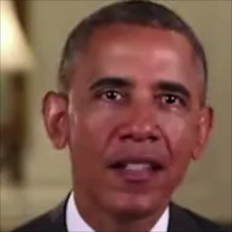

OUTPUTS

Slide 27
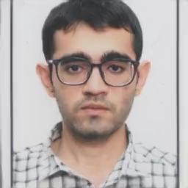

Slide 28

COLAB LINK FOR CODE
https://colab.research.google.com/github/AliaksandrSiarohin/first-order-model/blob/master/demo.ipynb#scrollTo=Oxi6-riLOgnm

Slide 29
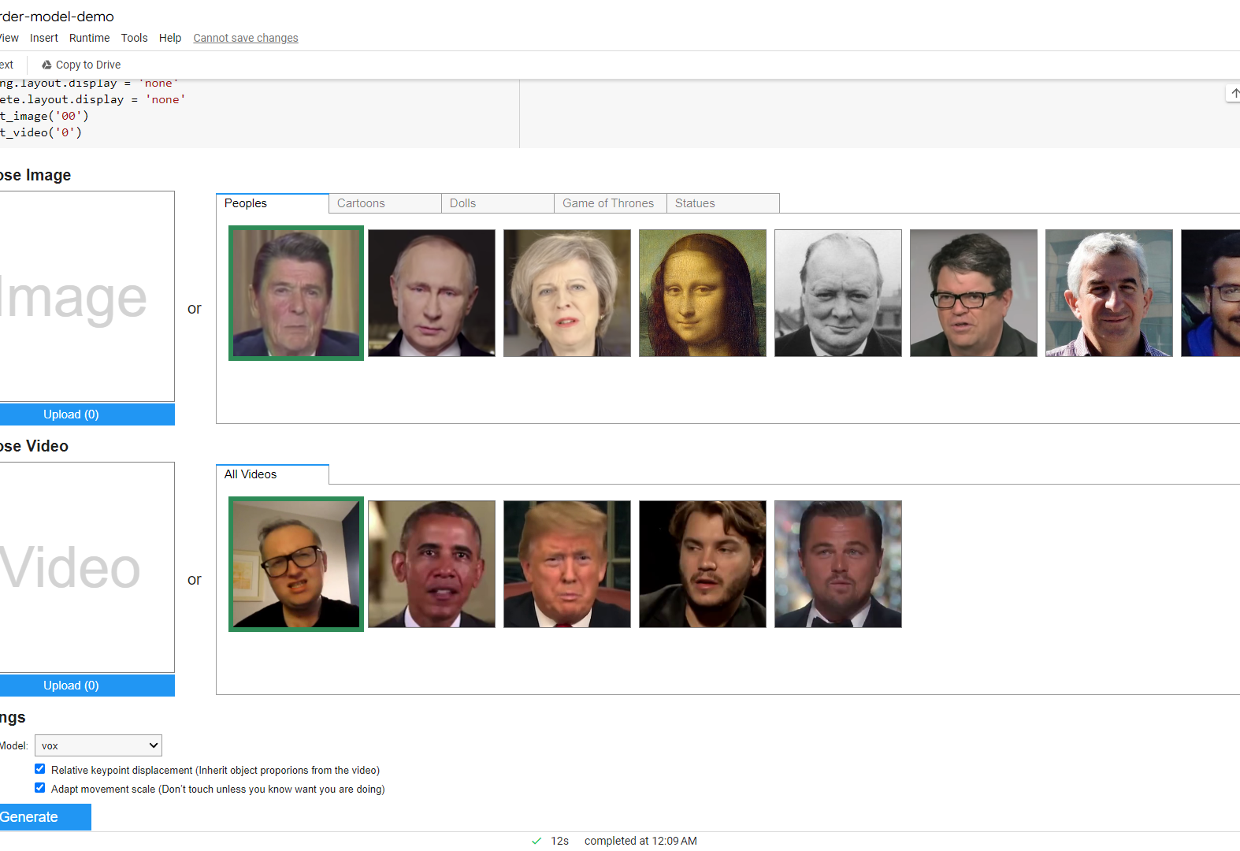
COLAB LINK FOR CODE
https://colab.research.google.com/github/AliaksandrSiarohin/first-order-model/blob/master/demo.ipynb#scrollTo=Oxi6-riLOgnm

Slide 30


